Slide 1
Pages Covered
📊
Dashboard
📅
Sales Calendar
BUSINESS
INTELLIGENCE
📦
Products & Stock
⏰
Expiry Tracker
Advanced AI Sales Intelligence Platform
💹
Profit & Loss
🔮
AI Demand Forecast
React • PHP • MySQL • Python ML/AI
🎯
What-If Simulator
🔔
Notifications
Presented by: Srinivasan • 2026

Slide 2
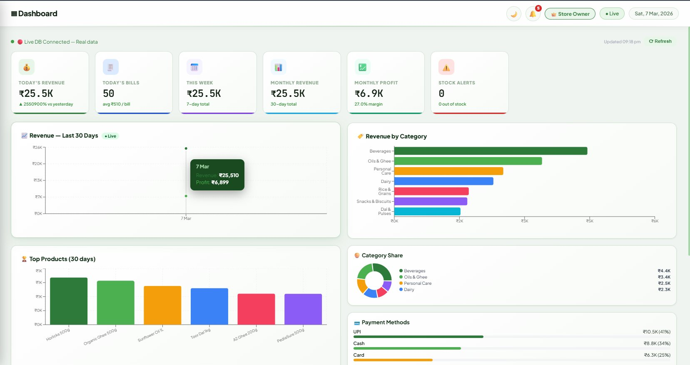
📊 Dashboard
Key Highlights
1
Live KPI Cards
Today's revenue, bills, weekly & monthly totals — all live from MySQL DB
2
Revenue Charts
30-day area chart + top products bar chart updated in real time
3
Category & Payment
Revenue by category + payment method breakdown (UPI, Cash, Card)
Presented by: Srinivasan • Business Intelligence Platform • 2026

Slide 3
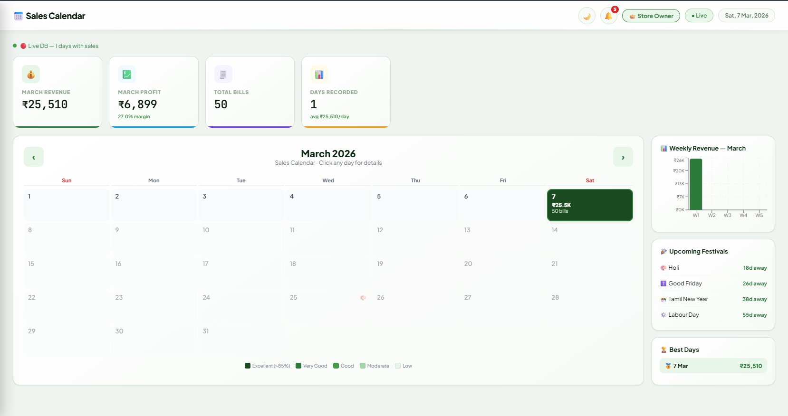
📅 Sales Calendar
Key Highlights
1
Heat Map Calendar
Each day colored by performance — Excellent, Good, Moderate, Low
2
Click Any Day
Click any date to view that day's bill details & revenue breakdown
3
Festival Tracker
Upcoming festivals shown — Holi, Tamil New Year, Labour Day & more
Presented by: Srinivasan • Business Intelligence Platform • 2026

Slide 4
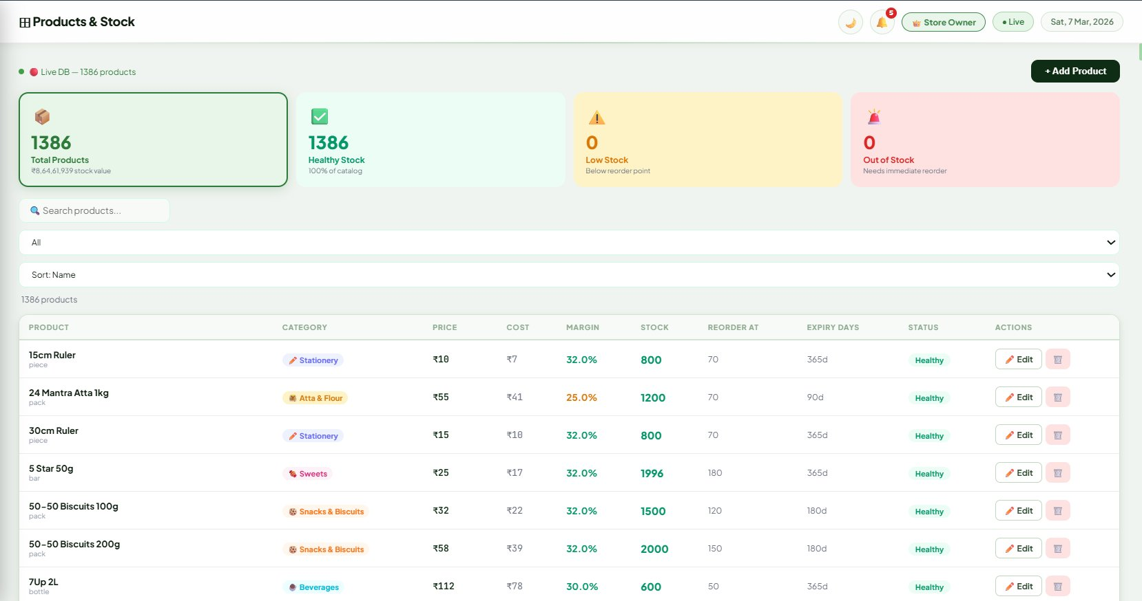
📦 Products & Stock
Key Highlights
1
1386 Products Live
Full catalog with price, cost, margin, stock & expiry days per product
2
Stock Status
Healthy, Low Stock & Out-of-Stock badges — reorder point auto-tracked
3
Search & Edit
Search by name/category, sort, add new products or edit existing ones
Presented by: Srinivasan • Business Intelligence Platform • 2026

Slide 5
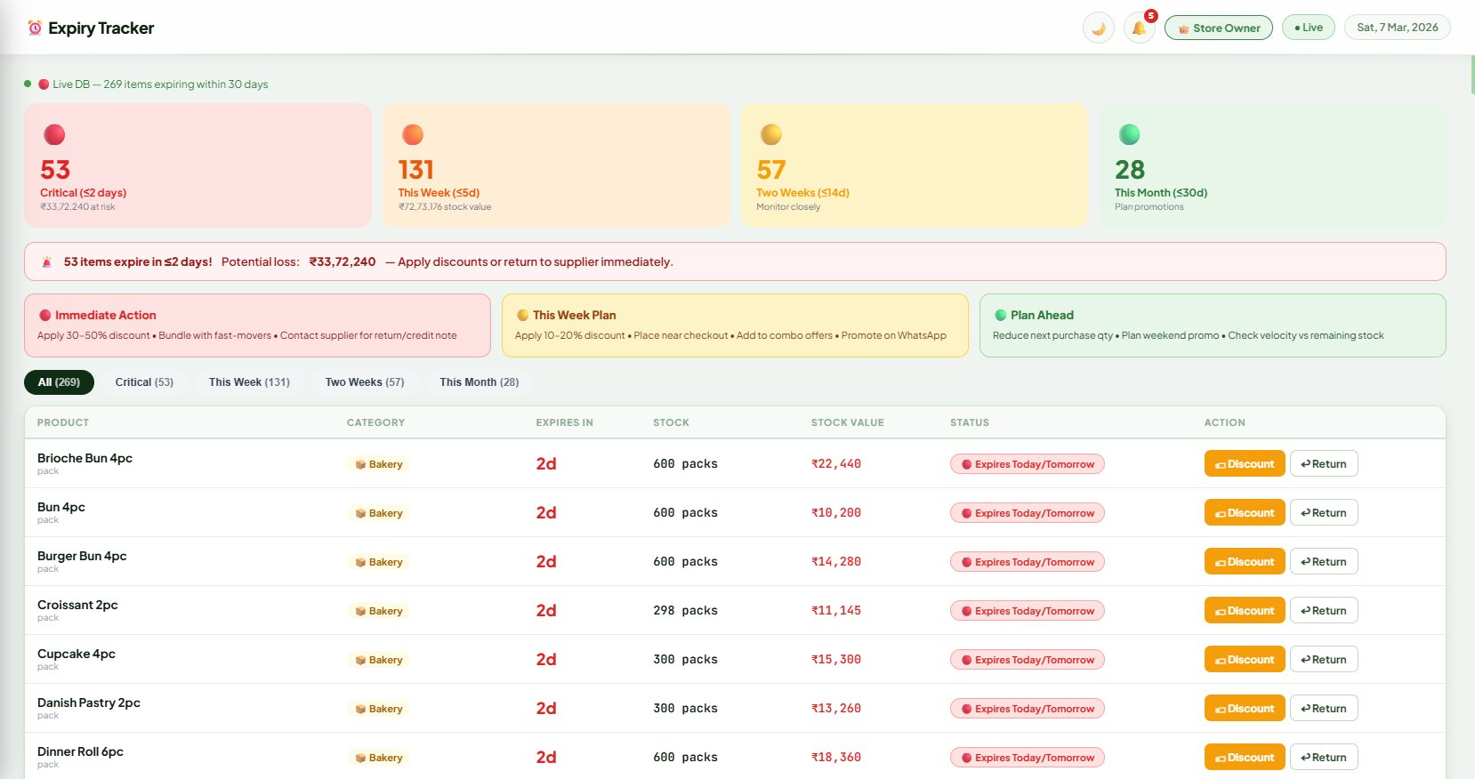
⏰ Expiry Tracker
Key Highlights
1
53 Critical Items
Products expiring ≤2 days — ₹33,72,240 at risk, take action immediately
2
Smart Actions
Immediate Discount / Return to supplier buttons on every expiring item
3
Zone-wise Plan
Immediate Action → This Week Plan → Plan Ahead — 3-level strategy
Presented by: Srinivasan • Business Intelligence Platform • 2026

Slide 6
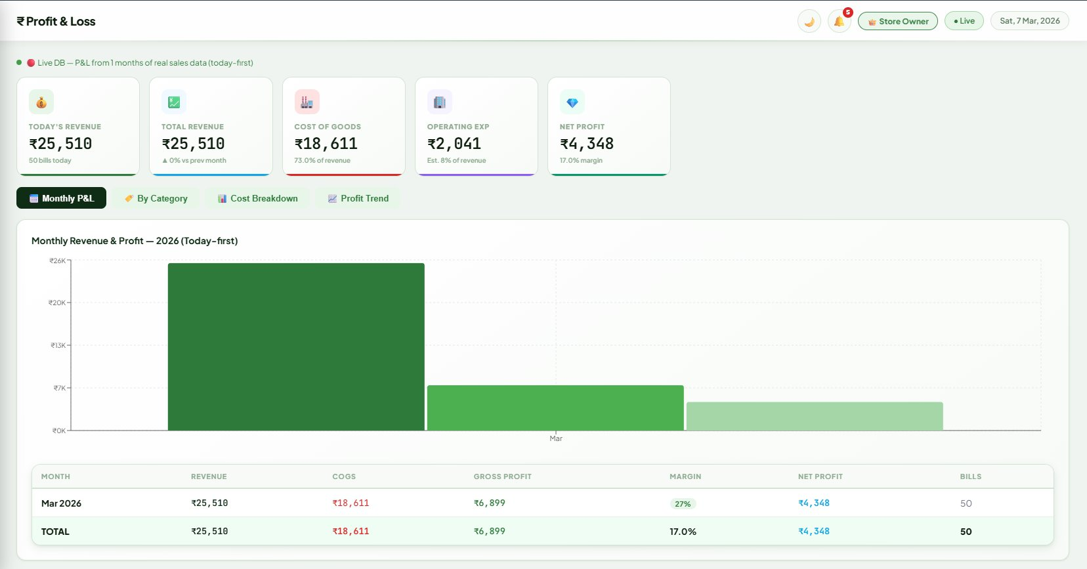
💹 Profit & Loss
Key Highlights
1
Full P&L Statement
Today's revenue ₹25,510 — COGS ₹18,611 — Net Profit ₹4,348 (17% margin)
2
Monthly Bar Chart
Monthly Revenue & Profit chart — compare revenue, COGS & profit visually
3
Tab Views
Monthly P&L / By Category / Cost Breakdown / Profit Trend — 4 views
Presented by: Srinivasan • Business Intelligence Platform • 2026

Slide 7
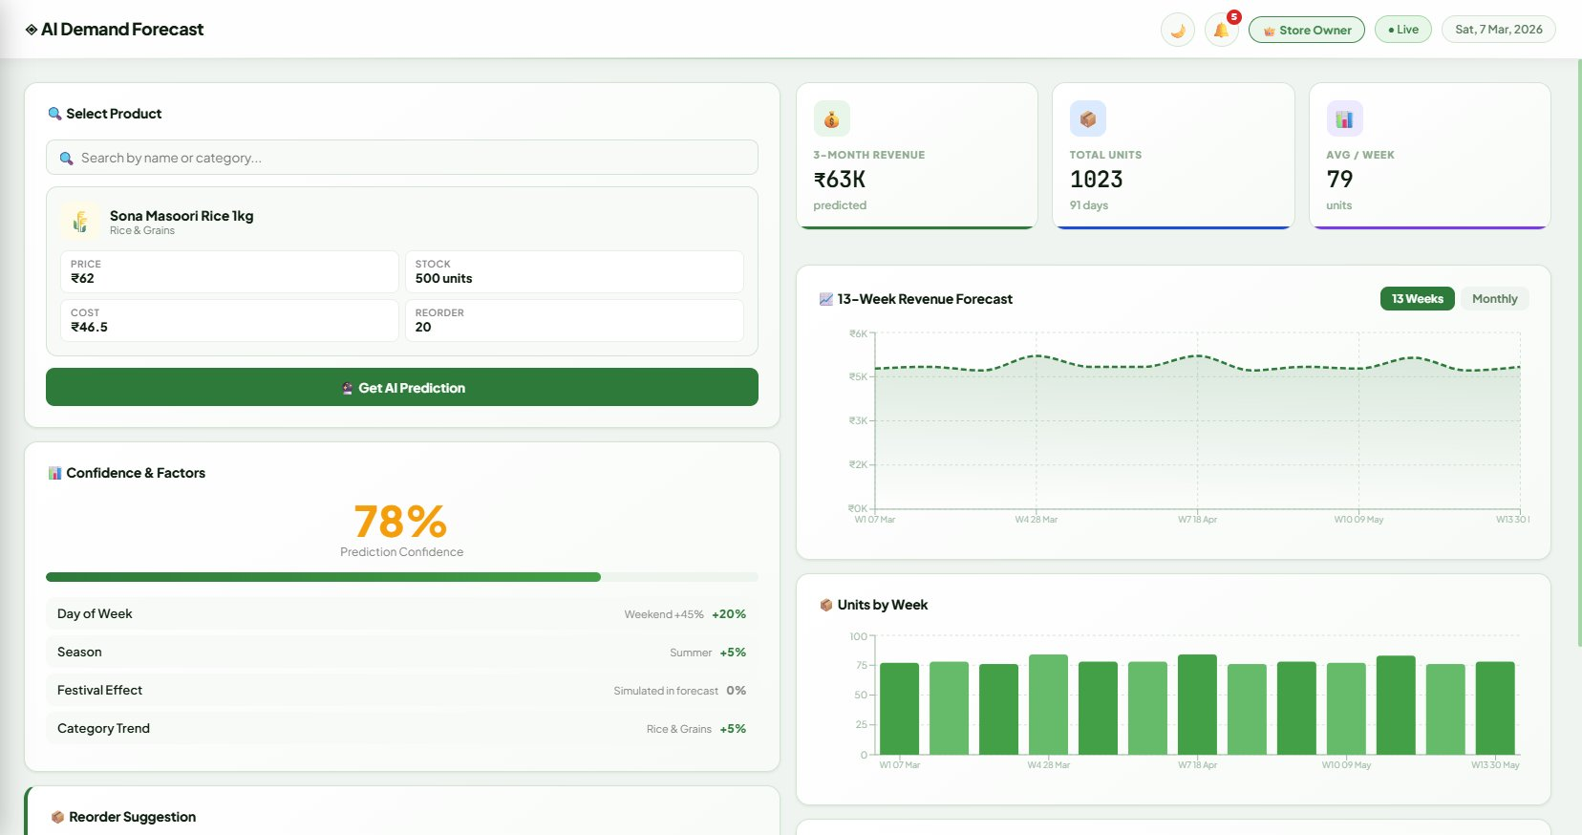
🔮 AI Demand Forecast
Key Highlights
1
78% Confidence
Gradient Boosting model predicts 13-week revenue & units for any product
2
Factor Analysis
Day of week, Season, Festival effect & Category trend — all factored in
3
Reorder Suggestion
Auto recommends when & how much to reorder based on predicted demand
Presented by: Srinivasan • Business Intelligence Platform • 2026

Slide 8
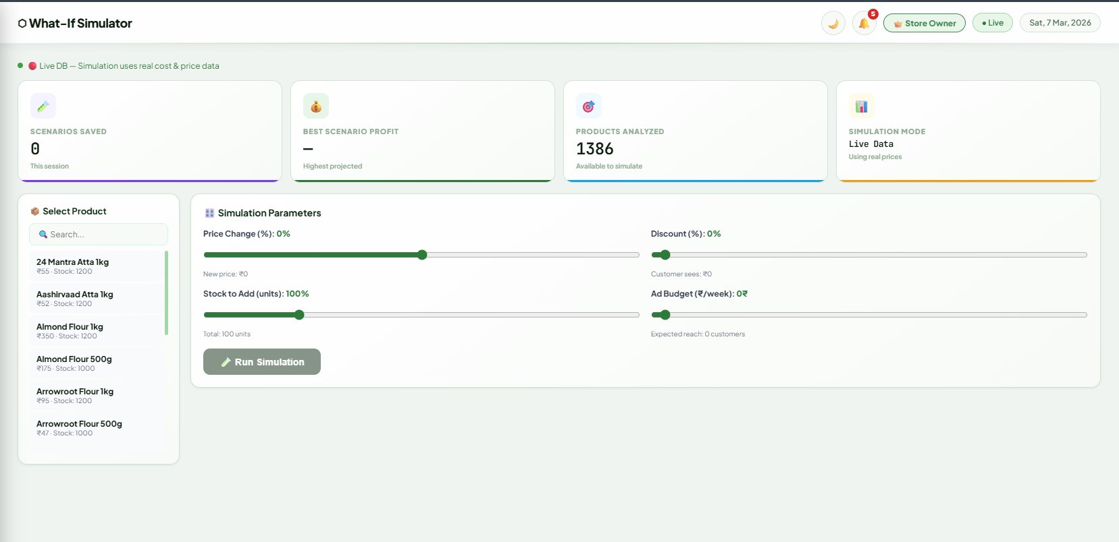
🎯 What-If Simulator
Key Highlights
1
1386 Products Ready
Pick any product, adjust sliders — see projected revenue & profit instantly
2
4 Simulation Sliders
Price Change %, Discount %, Stock to Add, Ad Budget (₹/week)
3
Live Data Mode
All simulations use real cost & price data — no guesswork, real results
Presented by: Srinivasan • Business Intelligence Platform • 2026

Slide 9
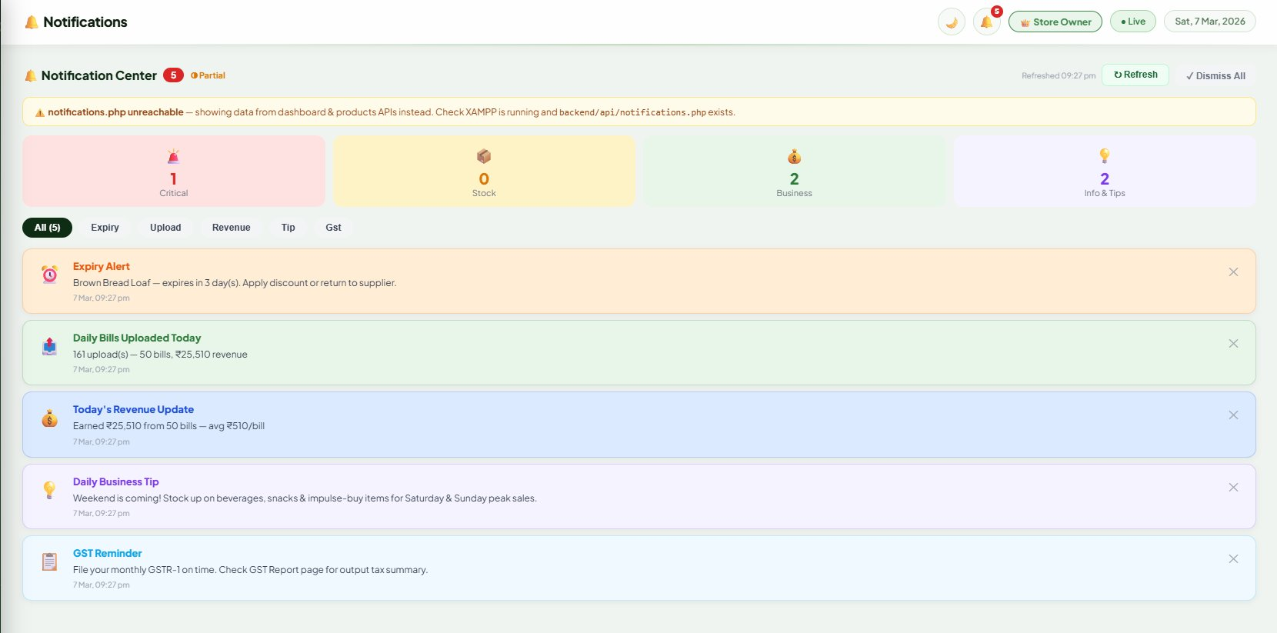
🔔 Notifications Center
Key Highlights
1
5 Active Alerts
Critical, Stock, Business & Info alerts — all in one organized center
2
Category Filters
Filter by Expiry / Upload / Revenue / Tip / GST — find alerts fast
3
Business Tips
Daily actionable tips — e.g. stock beverages before weekend peak sales
Presented by: Srinivasan • Business Intelligence Platform • 2026

Slide 10
Thank You
Business Intelligence
Tech Stack:
Frontend:
React 18 + Recharts + React Router
Backend:
PHP 8.x + MySQL 8.x REST API
ML Service:
Python 3.10 + Flask + scikit-learn
Design:
Dark Theme + Google Fonts + Custom CSS
Presented by: Srinivasan • Business Intelligence Platform • 2026

